Slide 1
Fabric Databases and AI: Using vector search in Fabric Databases for AI architectures
Dennes Torres

Slide 2







Dennes Torres Data Platform MVP (Alumni)
Dtower Software & Onyx Data
https://dtowersoftware.com
Trainer
MCT, Azure Solutions Architect, Azure Data Engineer and Azure DevOps Engineer
Malta Data Platform UG Leader
Malta
MMDPUG
https://www.facebook.com/MMDPUG
http://dennestorres.com
Dennes.Torres
@Dennes
https://br.linkedin.com/in/dennestorres
dennes@DTowerSoftware.com
http://youtube.com/c/dennestorres

Slide 3
Fabric Databases

Slide 4
Fabric Databases
Fabric Database are based Azure SQL
The features are the same
These demonstrations work in Azure SQL

Slide 5
Vector Search and AI Chat Solutions

Slide 6
AI RAG Architecture
RAG Architecture allow us to feed a chat bot with enterprise private information to receive custom answers

Slide 7
What’s Embedding
Embedding is a specific type of vector
Used for NLP and search
Vector and Embedding are synonyms in the AI Context

Slide 8
RAG on Azure: Step by Step
The user makes a question to Azure Open AI

Slide 9
Retrieval-Augmented Generation : RAG
User Question
Azure Open AI
Coordination

Slide 10
RAG on Azure: Step by Step
The user makes a question to Azure Open AI
AOA create embeddings/vectors for the question

Slide 11
Retrieval-Augmented Generation : RAG
User Question
Azure Open AI
Coordination
Embeddings Model

Slide 12
RAG on Azure: Step by Step
The user makes a question to Azure Open AI
AOA create embeddings/vectors for the question
AOA uses the embeddings to search related documents

Slide 13
Retrieval-Augmented Generation : RAG
User Question
Azure Open AI
Coordination
Embeddings Model
Retrieval (AI Search)

Slide 14
RAG on Azure: Step by Step
The user makes a question to Azure Open AI
AOA create embeddings/vectors for the question
AOA uses the embeddings to search related documents
AOA Builds the prompt using the located documents
AOA Sends the prompt to the GPT model
AOA Receives the answer and delivers to the user

Slide 15
RAG on Azure: Step by Step
The user makes a question to Azure Open AI
AOA create embeddings/vectors for the question
AOA uses the embeddings to search related documents
AOA Builds the prompt using the located documents
AOA Sends the prompt to the GPT model
AOA Receives the answer and delivers to the user

Slide 16
Retrieval-Augmented Generation : RAG
User Question
Azure Open AI
Coordination
Embeddings Model
Augmented Generation (GPT)
Retrieval (AI Search)
The Model Is here

Slide 17
Retrieval-Augmented Generation : RAG
User Question
Azure Open AI
Coordination
Embeddings Model
Augmented Generation (GPT)
Retrieval (AI Search)
The Model Is here

Slide 18
RAG Limitations

Slide 19
RAG Limitations
It’s a document search
It’s limited by prompt size
It lacks database level precision

Slide 20
Lack of Database Level Precision
Could you list the orders from customer XPTO ?
Could you list the sales from John ?
Could you list the bicycles orders ?
No Database Level Precision

Slide 21
Vector Search in Relational Databases

Slide 22
Vector Search and Possibilities
It’s part of the RAG architecture
A different method to implement RAG
Workaround for database precision answers
Advanced Text Search
Natural Language Text Search

Slide 23
How Vector Search Works

Slide 24
Main New Features
Vector Data Type
Vector_Distance function

Slide 25
Additional Steps Requirements
Generate
Generate Embeddings for the records
Generate
Generate Embeddings for the NL question
Build
If needed: Build a prompt for NLP question
Execute
If needed: Execute NLP question

Slide 26
sp_invoke_external_rest_endpoint
External API calls from T-SQL
Requires a Credential Object
Can call Azure Open AI Service
Can call for embeddings or GPT
Only call Azure URLs
Outside Azure URLs can use APIM

Slide 27
Creating the vector field
Maximum Field Size: 1998
alter table [dbo].[walmart_product_details]
add product_description_vector vector(1536) null;
The size depends on the embedding algorithm
Algorithm | Size
text-embedding-ada-002 | 1536
text-embedding-3-large | 3072
BERT | 768
MiniLM | 384

Slide 28
Credential
create database scoped credential [https://aiopentraining.openai.azure.com/]
with identity = 'HTTPEndpointHeaders’,
secret = '{"api-key": “<<Your API Key>>"}';
go

Slide 29
Get Embedding Stored Procedure
create or alter procedure dbo.get_embedding
@deployedModelName nvarchar(1000),
@inputText nvarchar(max),
@embedding vector(1536) output
as
declare @retval int, @response nvarchar(max);
declare @payload nvarchar(max) = json_object('input': @inputText);
declare @url nvarchar(1000) = 'https://aiopentraining.openai.azure.com/openai/deployments/' + @deployedModelName + '/embeddings?api-version=2023-03-15-preview'
exec @retval = sp_invoke_external_rest_endpoint
@url = @url,
@method = 'POST',
@credential = [https://aiopentraining.openai.azure.com/],
@payload = @payload,
@response = @response output;
declare @re nvarchar(max) = null;
if (@retval = 0) begin
set @re = json_query(@response, '$.result.data[0].embedding')
end else begin
select @response as 'Error message from OpenAI API';
end
set @embedding = cast(@re as vector(1536));
return @retval
go

Slide 30
Build Embeddings for All Records
declare @i int = 1;
declare @text nvarchar(max);
declare @vector vector(1536);
while @i <= 30000
BEGIN
set @text = (SELECT isnull([product name],'') + ': ‘ +
isnull([Description],‘’)
from dbo.walmart_product_details where id = @i);
exec dbo.get_embedding 'textembedding', @text, @vector output;
update [dbo].[walmart_product_details] set [product_description_vector] =
@vector where id = @i;
set @i = @i + 1;
if @i % 100 = 0
begin
WAITFOR DELAY '00:00:05'; -- wait for 5 seconds, every 100 items
-- (to allow for OpenAI API rate limiting)
end
END

Slide 31
Search Products: The Actual Result
declare @search_text nvarchar(max) =
'help me plan a high school graduation party'
declare @search_vector vector(1536);
declare @retval int
exec @retval = dbo.get_embedding 'textembedding’,
@search_text,@search_vector output;
SELECT TOP(10)
id, [product name], description,
vector_distance('cosine', @search_vector, product_description_vector) AS distance
FROM [dbo].[walmart_product_details]
ORDER BY distance

Slide 32
Search Products with Vector Search

Slide 33
Next Step: GPT Q&A

Slide 34
Questioning GPT
It can be done in SQL or outside
Use previous result as data source
Additional analysis of the product list
Better explanation about how the products fit the purpose

Slide 35
Convert Product List to JSON
declare @search_text nvarchar(max)
= 'help me plan a high school graduation party'
declare @search_vector vector(1536);
declare @retval int
declare @jproducts nvarchar(max)
exec @retval = dbo.get_embedding 'textembedding', @search_text,
@search_vector output;
with jRows as (
SELECT TOP(10)
json_object('id':id, 'productName': [product name],'description': description) as product
FROM [dbo].[walmart_product_details]
ORDER BY vector_distance('cosine', @search_vector, product_description_vector)
)
select @jproducts=json_arrayagg(product)
from jRows

Slide 36
Build the Prompt to GPT
declare @llm_payload nvarchar(max);
set @llm_payload =
json_object(
'messages': json_array(
json_object(
'role':'system',
'content':’
<<system message goes here>> ## Source ##
' + @jproducts + '
## End ##
<<More system message goes here>> '
),
json_object(
'role':'user',
'content': + @search_text
)
),
'max_tokens': 3000,
'temperature': 0.7,
'frequency_penalty': 0,
'presence_penalty': 0,
'top_p': 0.95,
'stop': null );

Slide 37
Make the GPT call
declare @response nvarchar(max);
exec @retval = sp_invoke_external_rest_endpoint
@url = 'https://aiopentraining.openai.azure.com/openai/deployments/localgpt4o/chat/completions?api-version=2024-08-01-preview', -- Completions API
@headers = '{"Content-Type":"application/json"}',
@method = 'POST',
@credential = [https://aiopentraining.openai.azure.com/],
@timeout = 120,
@payload = @llm_payload,
@response = @response output;
select [key], [value]
from openjson((
select t.value
from openjson(@response, '$.result.choices') c cross apply openjson(c.value, '$.message') t
where t.[key]='content'
))

Slide 38
Final Touch
Transform this into a stored procedure

Slide 39
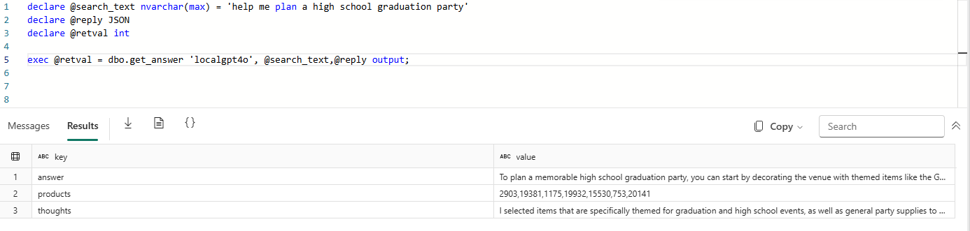
Make the Question

Slide 40
GPT Question

Slide 41

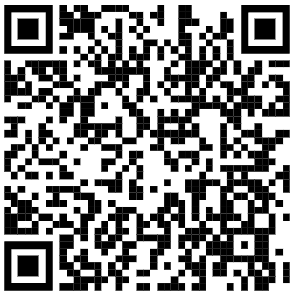
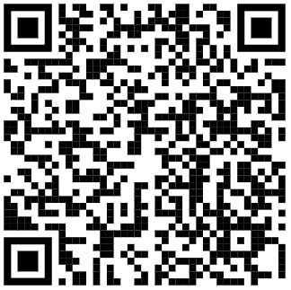
References
Files from this presentation
Wikipedia Walkthrough
Walmart Walkthrough

Slide 42
Dennes Torres Data Platform MVP (Alumni)
Dtower Software & Onyx Data
https://dtowersoftware.com
Trainer
MCT, Azure Solutions Architect, Azure Data Engineer and Azure DevOps Engineer
Malta Data Platform UG Leader
Malta
MMDPUG
https://www.facebook.com/MMDPUG
http://dennestorres.com
Dennes.Torres
@Dennes
https://br.linkedin.com/in/dennestorres
dennes@DTowerSoftware.com
http://youtube.com/c/dennestorres

